Slide 1
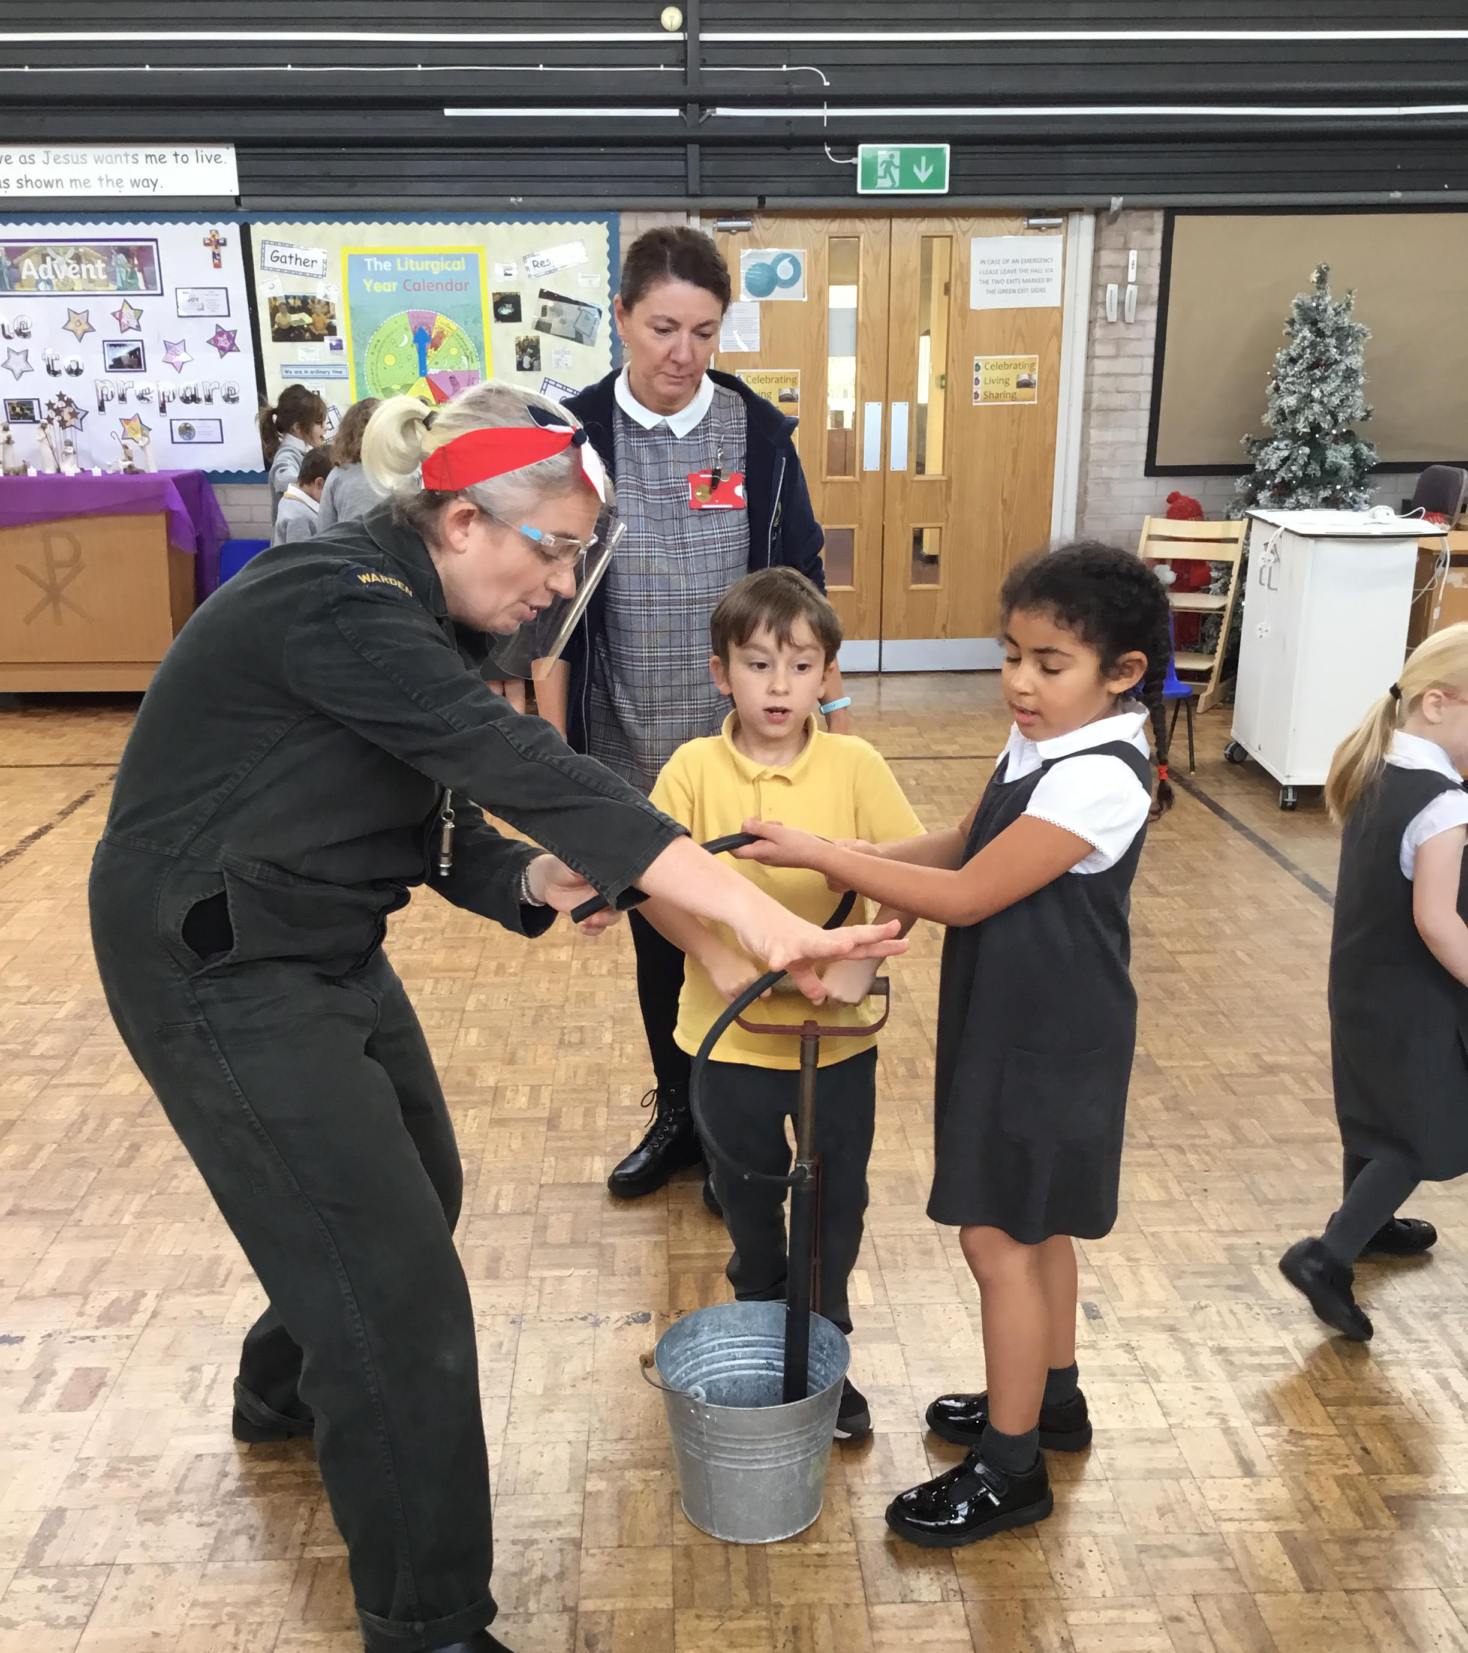
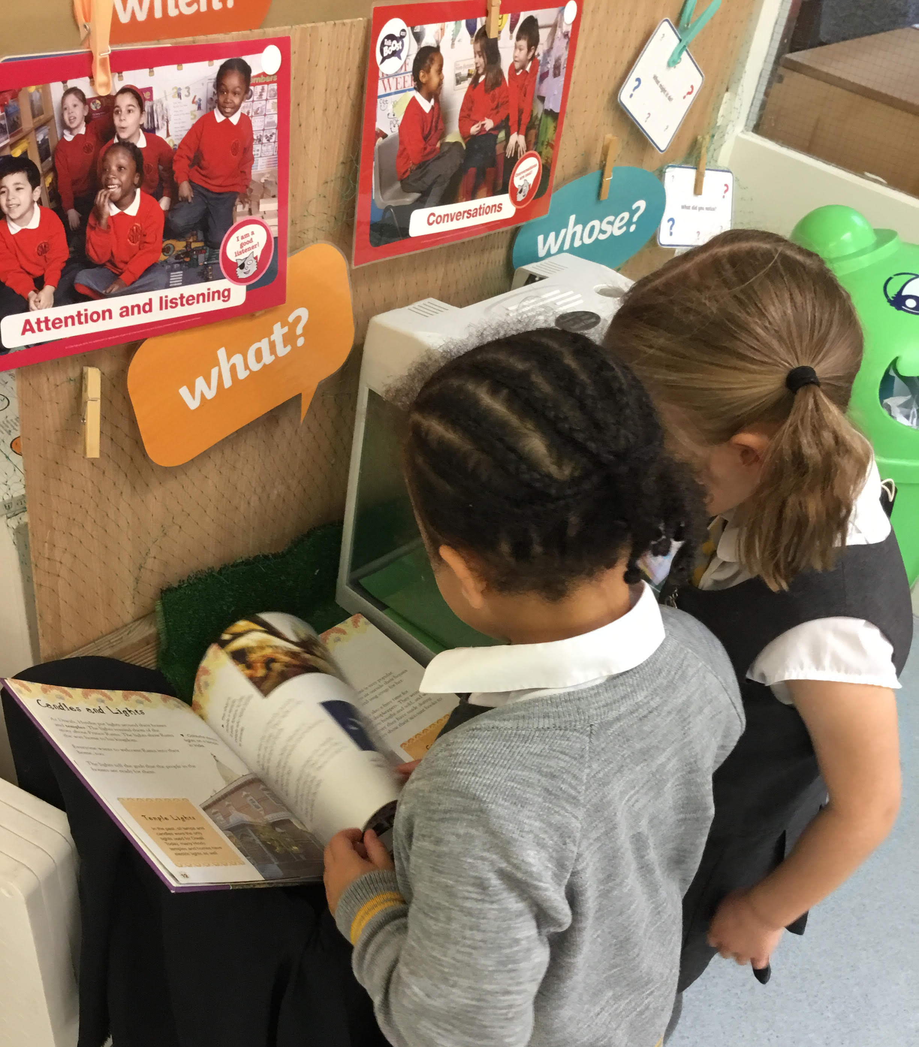
History at Cheadle Catholic Infant School by Claire Nelson

Slide 2
Love respect shine

Slide 3
Curriculum
Our comprehensive and bespoke curriculum has been designed with the needs and experiences of our children in mind. It has been developed in line with the EYFS framework and National Curriculum. The Scheme of Work is enquiry based and rigorously delivered to ensure that all children are given the best possible chance to succeed and develop the skills and knowledge they will need to enjoy and achieve at the end of Key Stage 1 and beyond. It draws on local inspiration and the children’s own experiences and is unique to our school and its location.

Slide 6
Key concepts: what are the big ideas?
In EYFS and Key stage 1 it is important that children encounter important concepts and ideas in an age-appropriate way. The history curriculum at our school is carefully designed to make sure that the concepts the children are introduced to set them up for success throughout our school and into Key Stage 2, creating a firm foundation for historical understanding.

Slide 7
Substantive (first order) concepts
The substantive concepts which run through our history curriculum and help children to understand recurring abstract themes within a historical context are:
Travel
The concept of travel is focused upon heavily in the Year 2 topic ‘How did transport change the world?’ However, the children come to this topic with prior knowledge because they have previously learnt about the first moon landing and astronauts in Reception and Seaside holidays in the past in Year 1.
Society
This is a more complex concept than travel but it is introduced gently for example by looking at the impact the arrival of the Windrush generation had on society (Y1, A2) looking at the differences between the experiences of rich and poor people during events such as the Great Fire of London (Y2, Spr2) and comparing the lives of landowners and servants living in Bramall Hall (Y1, Spr2). These topics begin to build up an idea of was like in the past and also begin to question how much has changed.

Slide 8
Substantive (first order) concepts
The substantive concepts which run through our history curriculum and help children to understand recurring abstract themes within a historical context are:
Monarchy
This concept links to the children’s developing geographical understanding in Year 1 and 2 where they find out about the U.K. and then the continents. This really needs to be in place for the children to have an idea about how far an empire can reach. Within our curriculum, the idea of empire is primarily based around the British Empire. This is central to the learning on the arrival of the Windrush (Y1, A2) and also the impact of George Stephenson’s Rocket (Y2, S1). It also features in a lot of our key anniversaries such as Remembrance day and special events like the Queen’s platinum jubilee.
Achievements
This

Slide 9
Disciplinary (second order) concepts
These are the common threads across historical teaching which are central to everything we teach (‘they can be said to cover what history is about, without the content’- Tim Jenner, HA Primary Journal 82). The children repeatedly meet these concepts in their learning and they help the children to make links between different aspects of historical learning so that their historical knowledge and thinking connects rather than being a series of stand alone topics.
The second order concepts are:
similarities and differences, significance, chronology, continuity and change, cause and consequence.

Slide 10
Pedagogy- how are lessons structured?
Enquiry Triangle
Recall previous learning -Quizzes, Can you still? Talk Partner Work, ‘Monday Memory Moments.’
Introduce new learning including new vocabulary-’my turn, your turn.’
DEAL, group work, talk partner work, peer support
‘Sticky learning’- rhymes, gestures and songs, school trips and workshops, ‘tap and tell’
Recording of new learning in a variety of ways
Mini plenaries

Slide 11
How is learning sequenced across the school? EYFS

Slide 12
KS1

Slide 13
Vocabulary
Vocabulary
In collaboration with other History Subject Leaders in Stockport, I complied a vocabulary list for EYFS and another for KS1 to help class teachers signpost key vocabulary to the children and ensure progression and repetition across school.

Slide 14
Pupil Voice 2022 What do they know? How well do they remember it?
Pupil voice activities with Year 1 and 2 children showed that the children were understanding and retaining the information they were being taught.
Year 2 children could talk confidently about what they had been taught in Y2 and Y1 which is good evidence of sticky learning.
Year 1 children showed a much more thorough understanding of the life of Floella Benjamin and the Windrush generation as a whole. I think this is because of the use of the text ‘Coming to England’ in English which gives the children many more opportunities to revisit the story than history lessons alone.
Children’s attitudes were positive. They were enjoying what they were learning about and enjoying the way that it was being taught.

Slide 15
Inclusion
We know that children with SEND can find the abstract nature of history and retention of facts difficult. We have written a document reflecting on this and how we have adapted our practise to give everyone the best chance to succeed. Our four key strategies for teaching are:
Strategy 1: Repeated Learning- the ’history mystery box,’ songs and rhymes, weekly quizzes
Strategy 2: Collaborative learning- groupwork (eg flat chat), paired work, whole class collaboration (DEAL)
Strategy 3: Duration of activity and avoidance of too much teacher talk.
Strategy 4: Recording in different ways- photographs, pictures, pot it notes, scribed writing, recording

Slide 16
SEND pupil voice 2023 Is our SEND document having an impact? Is it working?
Positives
- They remember names of people and recall facts
- Both Y1 and Y2 groups made explicit reference to books
- Varied teaching strategies such as m/a paired work, history workshop, drama, Mrs Boardman visiting y1 seem to be linked to the knowledge that stuck.
- Y2 could recall Y1 work as well as what they had worked on recently.
Things to think about
- They seem to remember people better than events
- Both groups struggled to remember/explain some of the more complicated vocabulary eg significant, jubilee, Wangari Mathaai (is she in their HM box?)
- Found it hard to define what history is
- Listening and staying ‘on task’ was a challenge for most in this short, small group situation: reminded me it must be so much harder for them in an actual history lesson and to keep the w/c delivery to a minimum.

Slide 18
Assessment- Measuring progress, knowledge, skills and challenge
In KS1 assessment sheets are completed by the class teacher at the end of each unit. This highlights children that are working towards the expected standard and working at the expected standard in History.
Tools used weekly as formative assessment include:
Monday Memory Game
Can you still?
Sticky Learning- end of lesson activity
History Mystery box

Slide 19
Strengths and next steps

